Slide 1

Anthony Ngo (antngo@microsoft.com) App. Innovation Specialist Global Black Belt
Notes:
Hello everyone, my name is Anthony Ngo and I am an App Innovation Specialist here at Microsoft – and today I’m going to be going over the setup of App Center as well as the Build portion. How many of you are familiar with App Center already? If not, what App Center is, is a DevOps solution to give you the ability to Build, Test, Monitor, and Distribute your apps. If you guys have used Xamarin Test Cloud, Xamarin Insights, HockeyApp, Codepush, etc before – what App Center does is put all of these services together under one roof. These were all separate products before, and I’m sure you guys know the pain of using so many different services. You had to have different log ins, remember different passwords, integrate all of them separate with your apps. But that is what we are looking to help with App Center. We’ve combined all of these services together to give you an easy streamlined DevOps solution for your apps.
I as well as the rest of the team here actually come from the Xamarin team, from when we were acquired about 2 years ago. So obviously we are biased towards C# but one thing that we aimed to do with App Center, is open it up to all developers, on any platform. Whether you are an iOS (obj-c/swift developer), an Android (Java developer), use react native, App Center will work great for your DevOps process.
Now go to into the setup process.

Slide 2
App Center: Setup
https://appcenter.ms/
Notes:
This is the link that you will want to follow in order to set up your App Center account. One thing that I want to point out on this screen is what I mentioned earlier. Whether you have an iOS, Android, Windows, React Native, or Xamarin app, you will be able to use App Center. Actually when our team was first developing this project, some of you may know that it used to be called Mobile Center. Originally, we were gearing this to be a mobile devops solution, but with how the market is changing, there are other apps out there. For example, there are macOS apps, and even tvOS apps. We are always looking to support more apps – and this is something that our team will continue to work on. Also why we also changed the name from Mobile Center to now App Center.

Slide 3
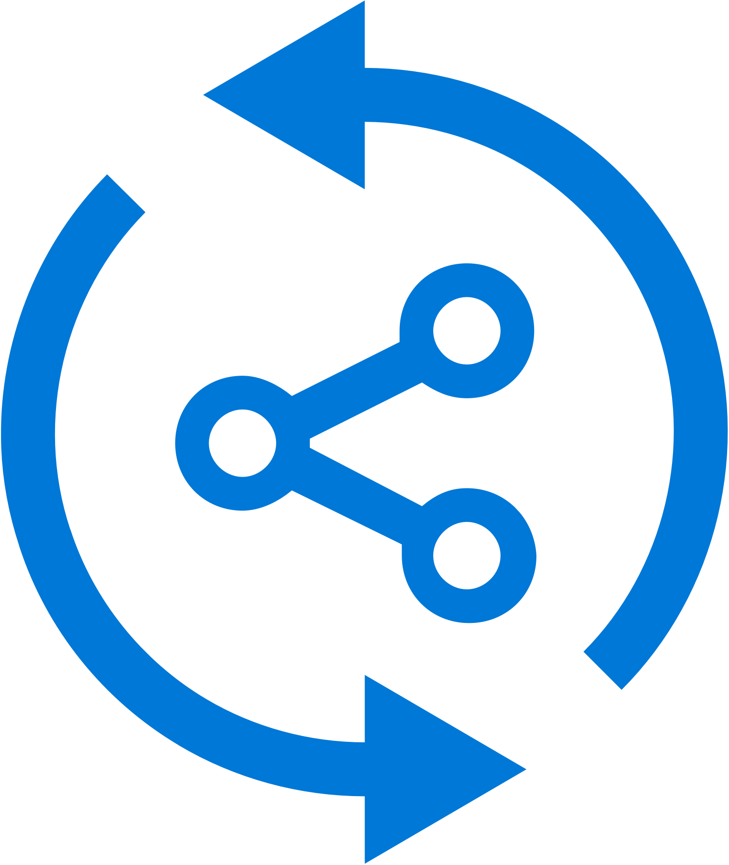

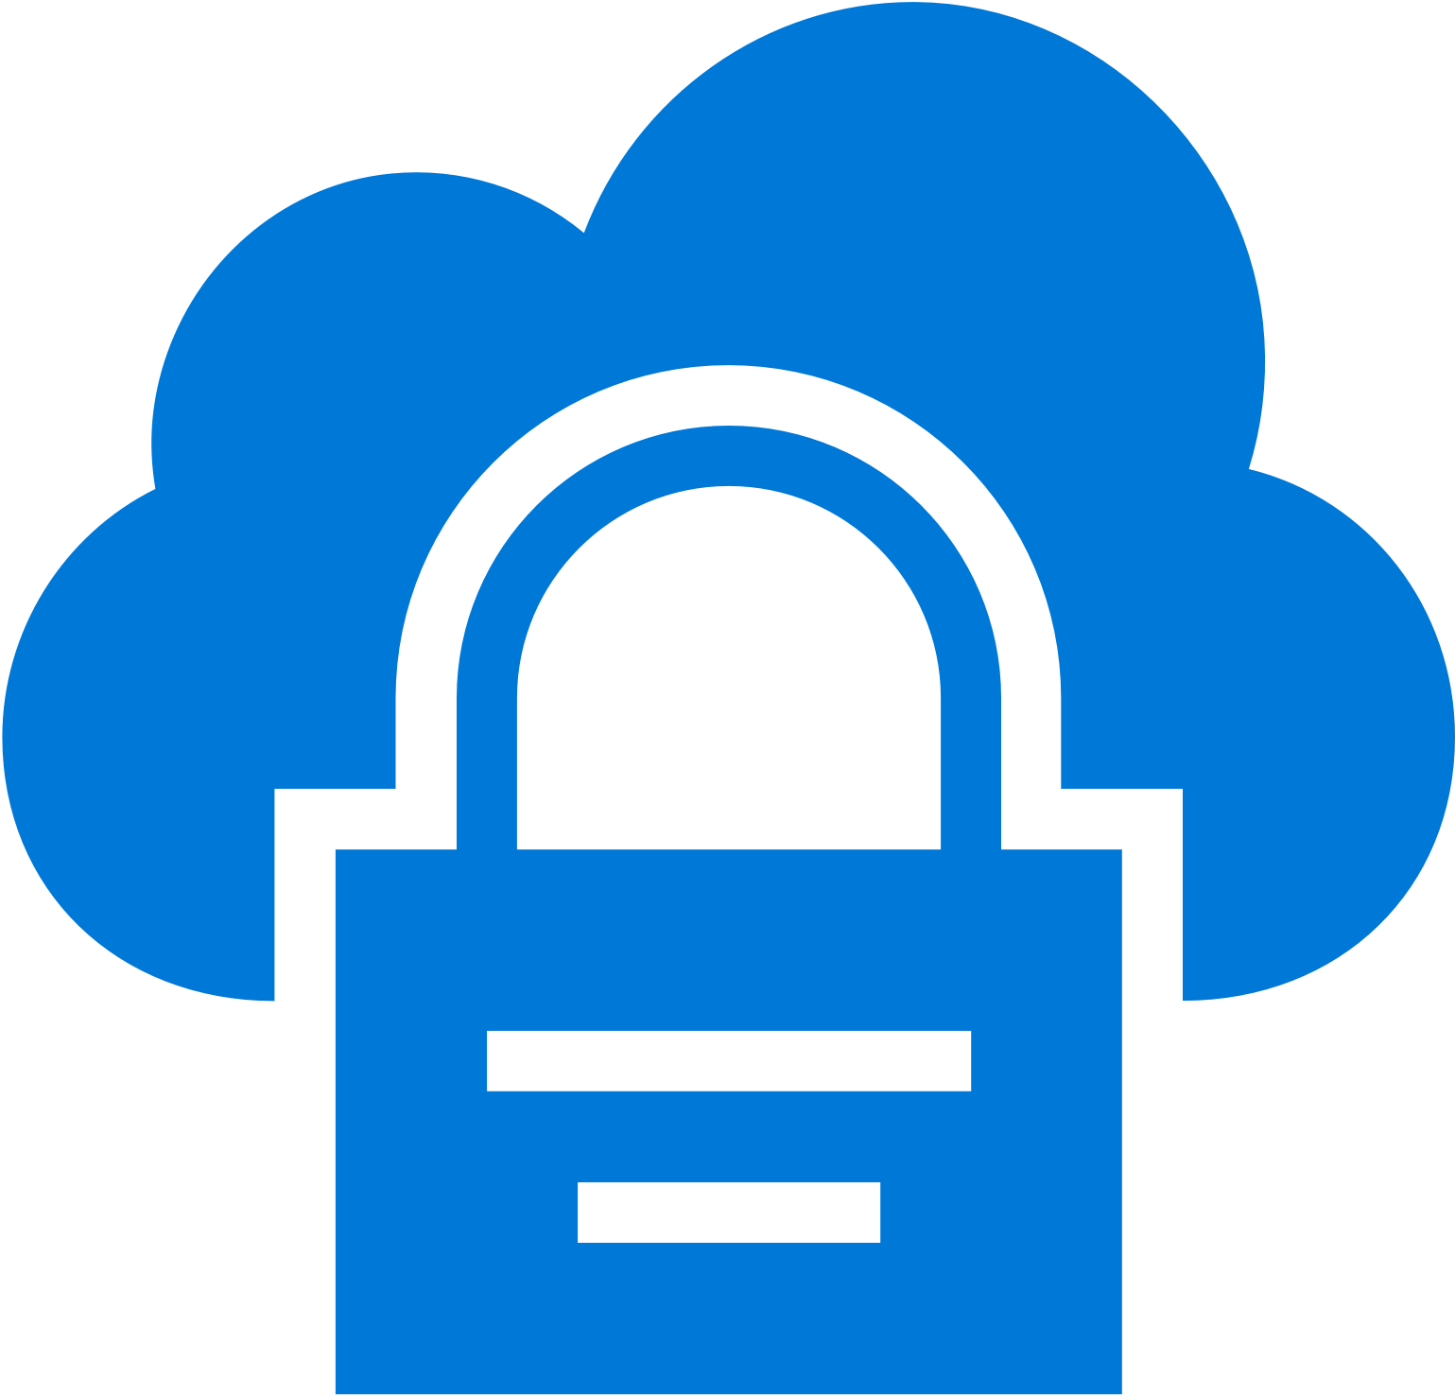
App Center: Build
Build-on-push
With just a few steps automatically build apps with every commit, and generate packages to test and distribute
Work with existing tools
Connect existing repositories in GitHub, Bitbucket, and Visual Studio Team Services with just a few clicks
Build securely in the cloud
Each build is run on a separate, clean virtual machine hosted on our secure cloud servers
Notes:
Each build is run on a separate, clean virtual machine and no other user has access to this virtual machine. Once the build is completed, the virtual machine is discarded and all files removed. The files resulting from the build (log files, application files, symbol files) are stored on Mobile Center servers.

Slide 4
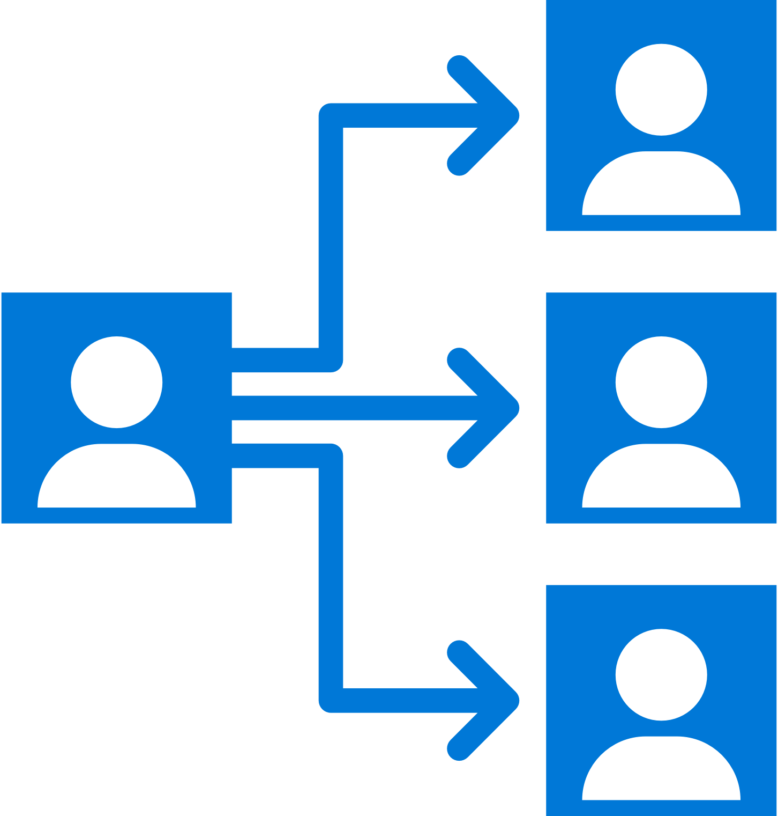
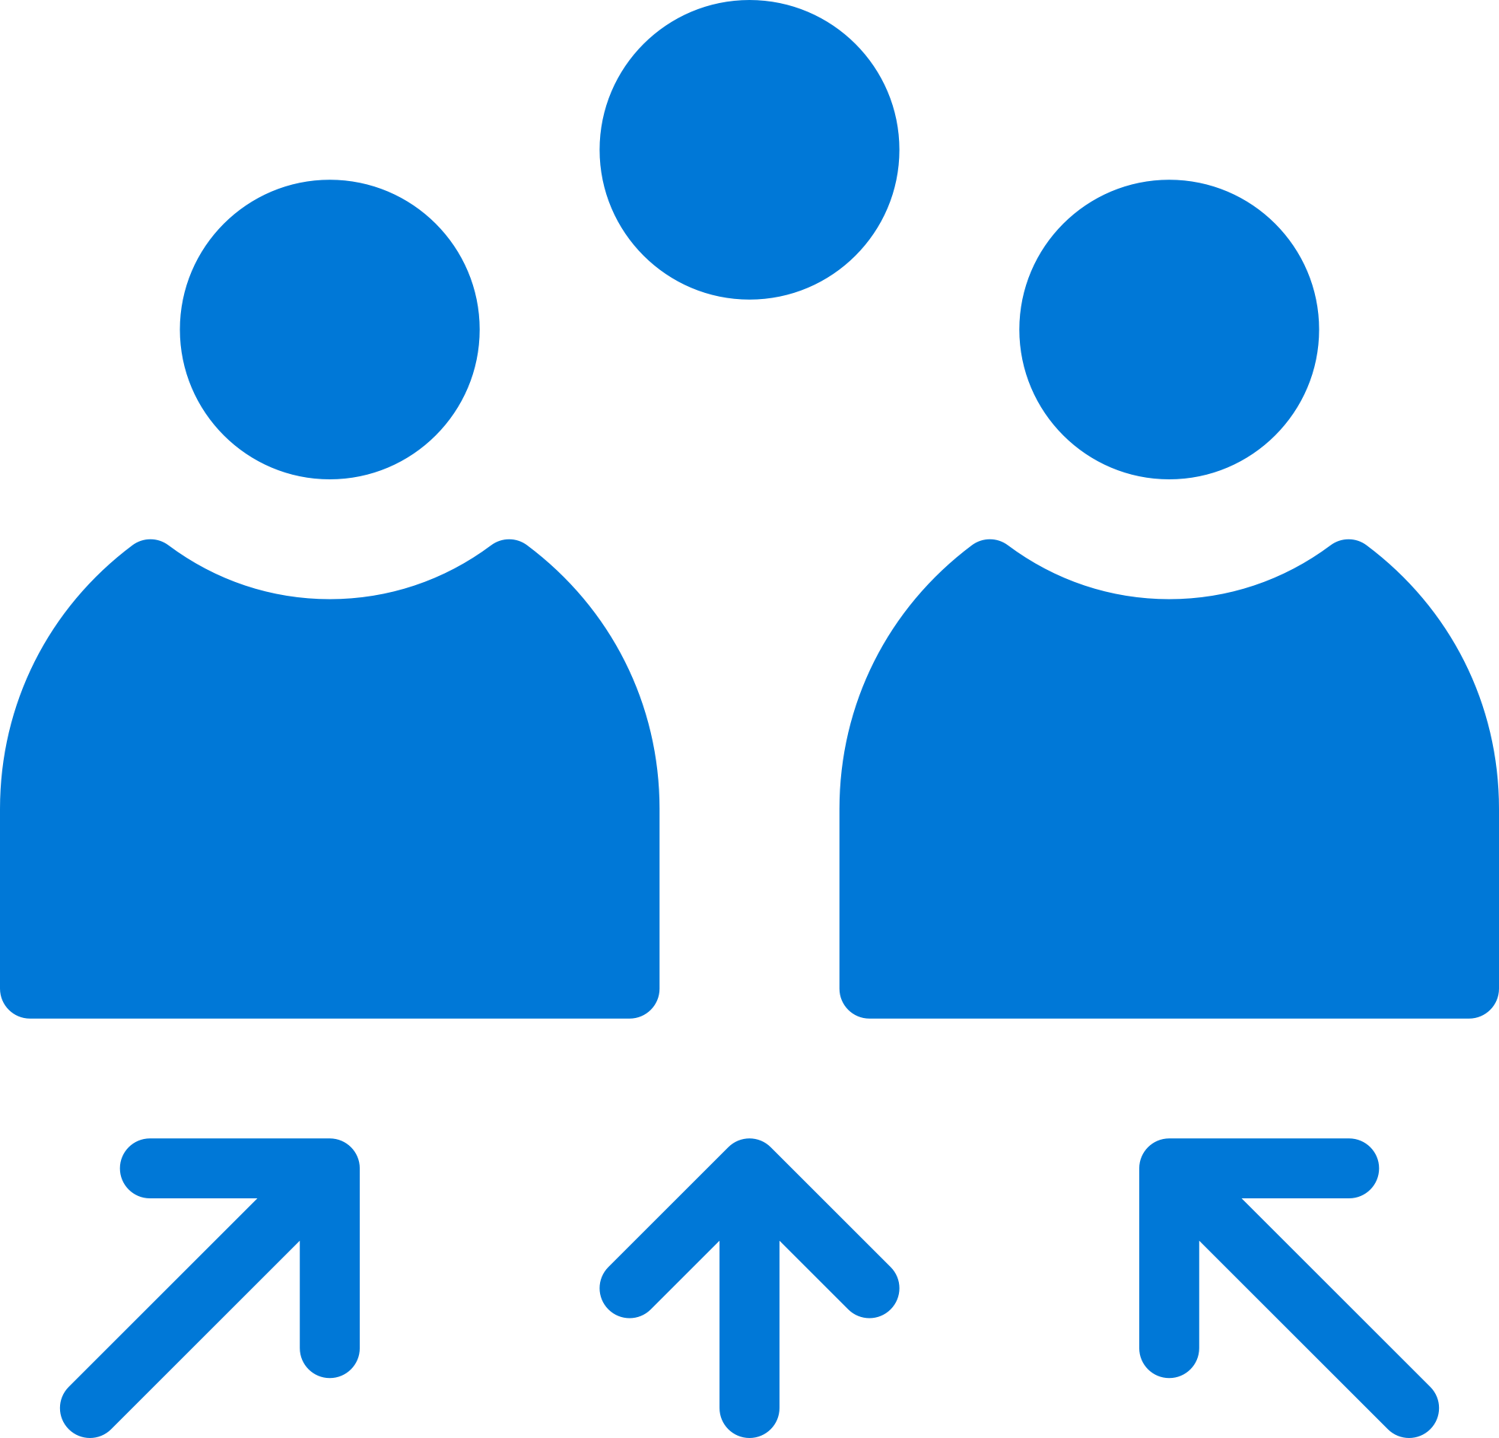
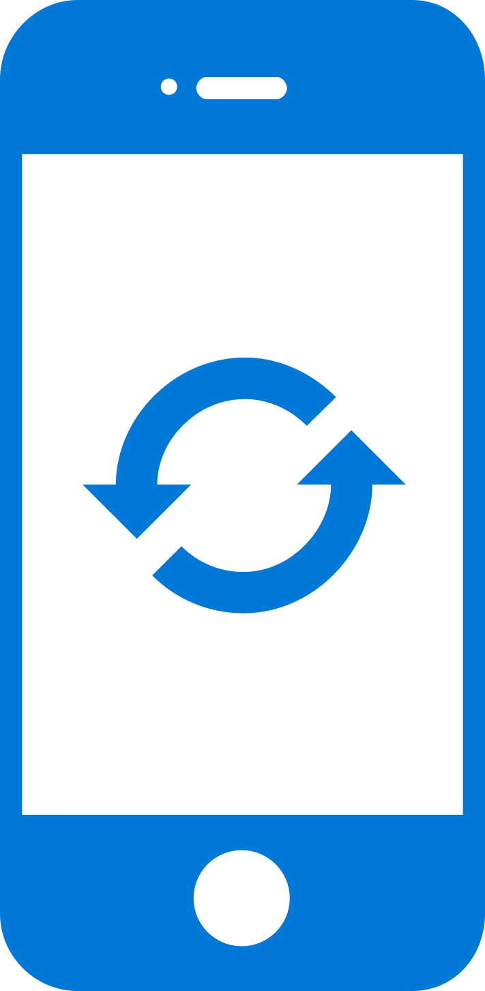
App Center: Distribute
Instantly distribute apps
Quickly get apps in the hands of your beta testers on multiple device platforms
Create targeted distribution groups
With categorized groups of users, send specific builds to specific groups and devices
Send in-app updates
Notify beta testers as soon as a new build is available, right inside the app
Notes:
-Click into my Distribute tab first (admin):
-Get ipa to distribute new release
-Intro self - where I'm coming from
-Distribute and managed crashes
-Link distribution to something familiar - any know what HockeyApp is? This is the next generation
What was HockeyApp and what is VSAC Distribute
-Weave in stories about difficulties that come with distribute –
-Groups: The distribute portal allows you to manage your distribution groups
Can have internal beta testers being distributed to our employees
Also can have a public alpha group that can access the app without being a part of the organization - you can achieve this by sending a link to the testers directly for them
Can still have it public - if you have a dev group or QA team offshore - makes it easier because you don't have to be on the same network
Once you hit distribute, all of the beta testers will receive an email to download the application
-If you integrate App Center SDK you can get in-app notifications of new releases (tell you to download the new version) - SDK will automatically delete the previous version of the app and re-upload the latest version
-You can find that SDK in the docs that Anthony pointed out in the beginning
-For those who are familiar with beta releases with iOS, you know how annoying it was to get beta users to download version, have to have a developer profile, then you have to provision the device using the UDID - annoying and difficult for users and developers
-Story about Brandon Monday Punday
-We all know how beta users are - we want to make this as easy as possible - especially if their participation isn't required (they're doing it as a favor) - especially early on when there are the most bugs you don't want to lose tester participation out the gate
-Eventually you'll want to publish this to the public app stores, and this service enables you to connect to the Google Play Store and the Apple App Store
-You'll still need to provision your profiles with the respective stores directly, but once that's set up App Center acts as the CD setup to push updates to the app with every new release
-We have a preview connection to the app stores - no portion of the mobile lifecycle is not going to be covered here - Easy to use each standalone feature individually - plus there's the end-to-end story there
Releases: # of downloads, can make it a mandatory update, can see who the beta testers are, tracks version #, build #, also keeps a history of the .apk or .ipa

Slide 5
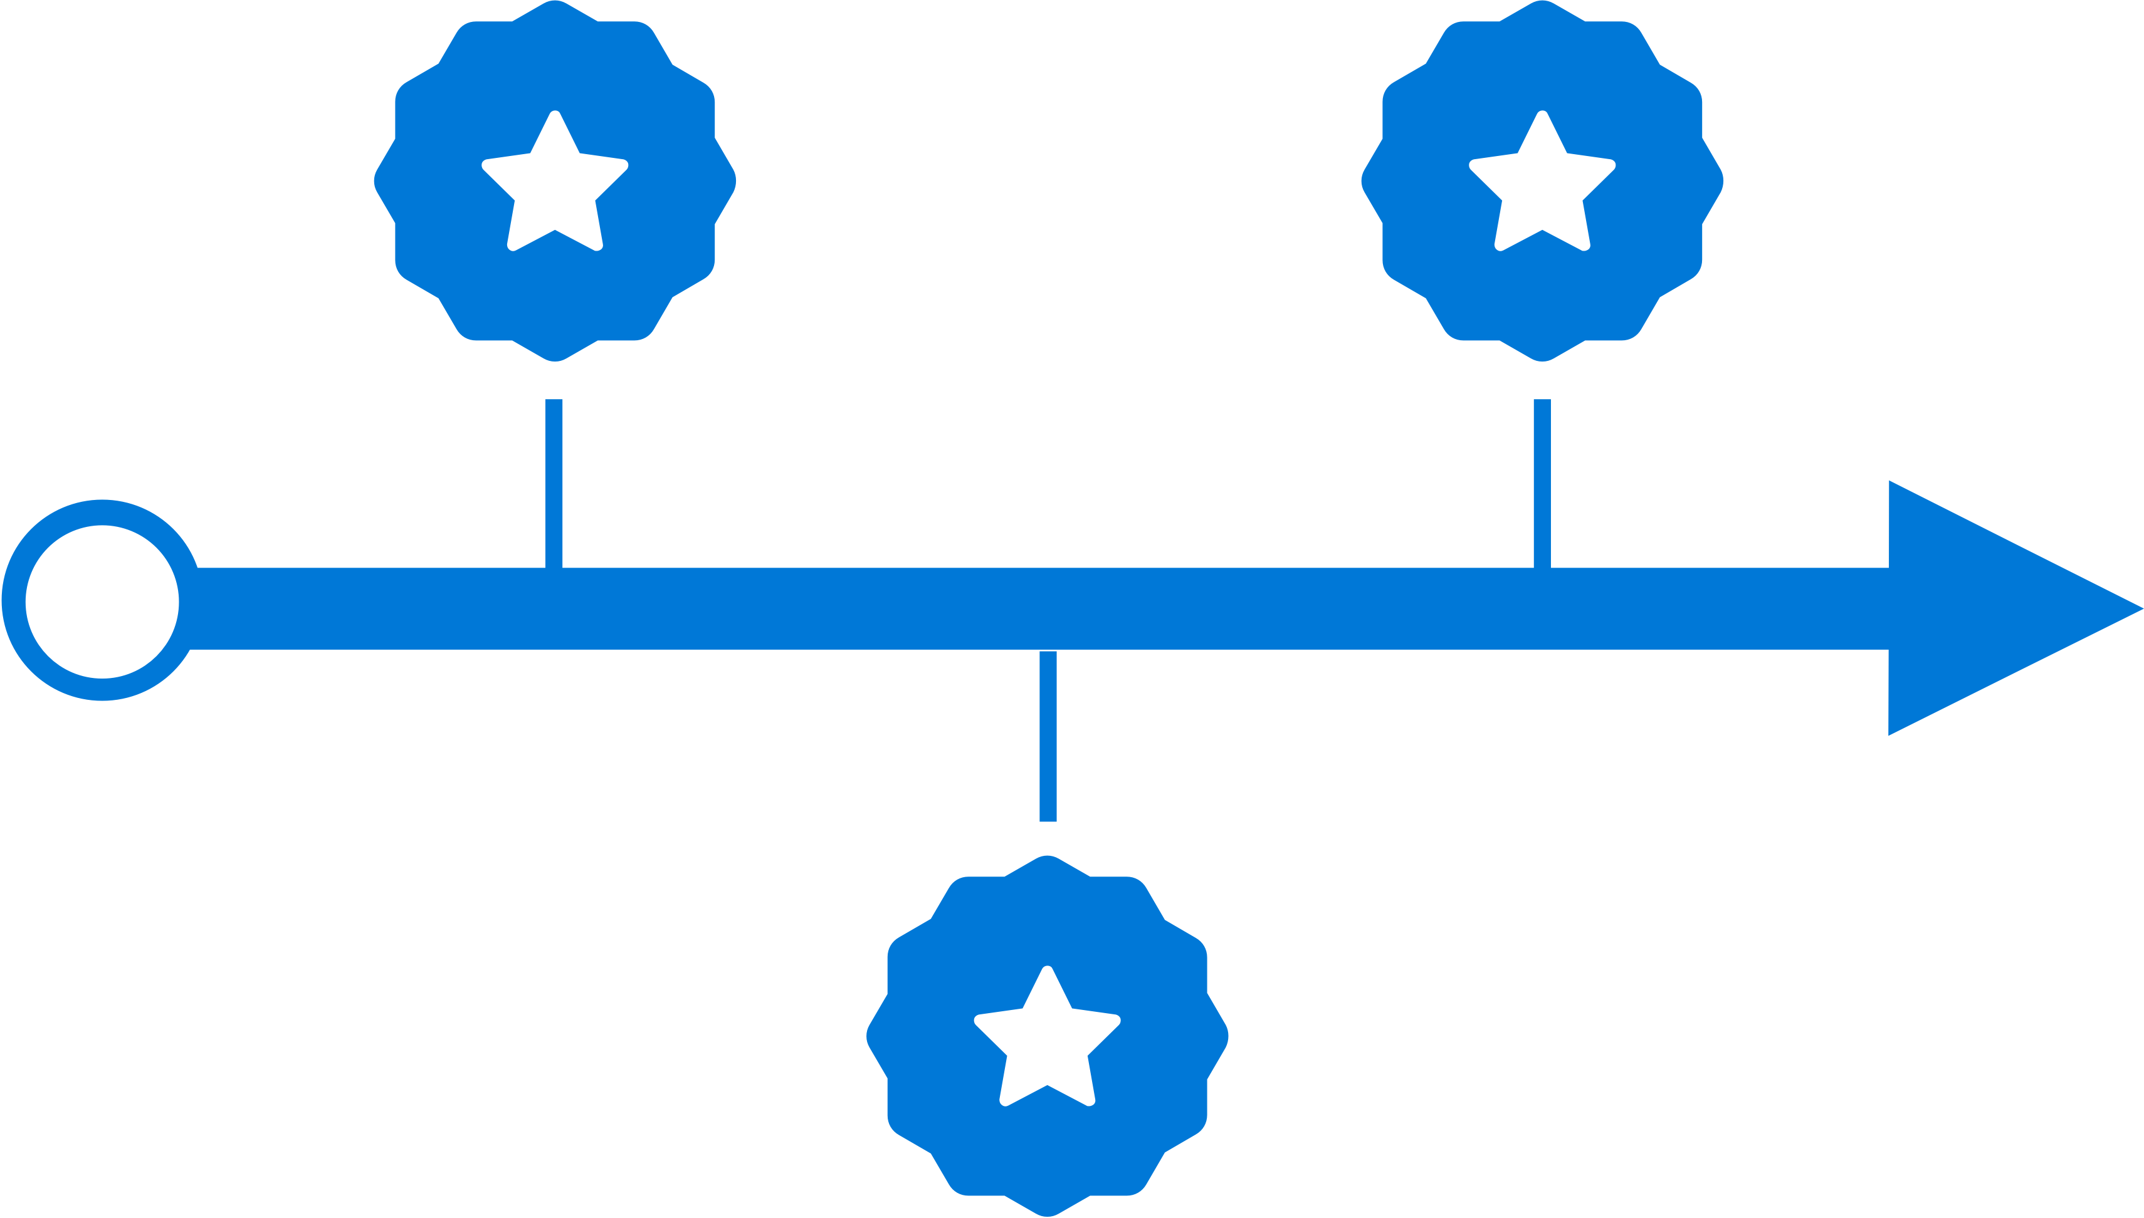

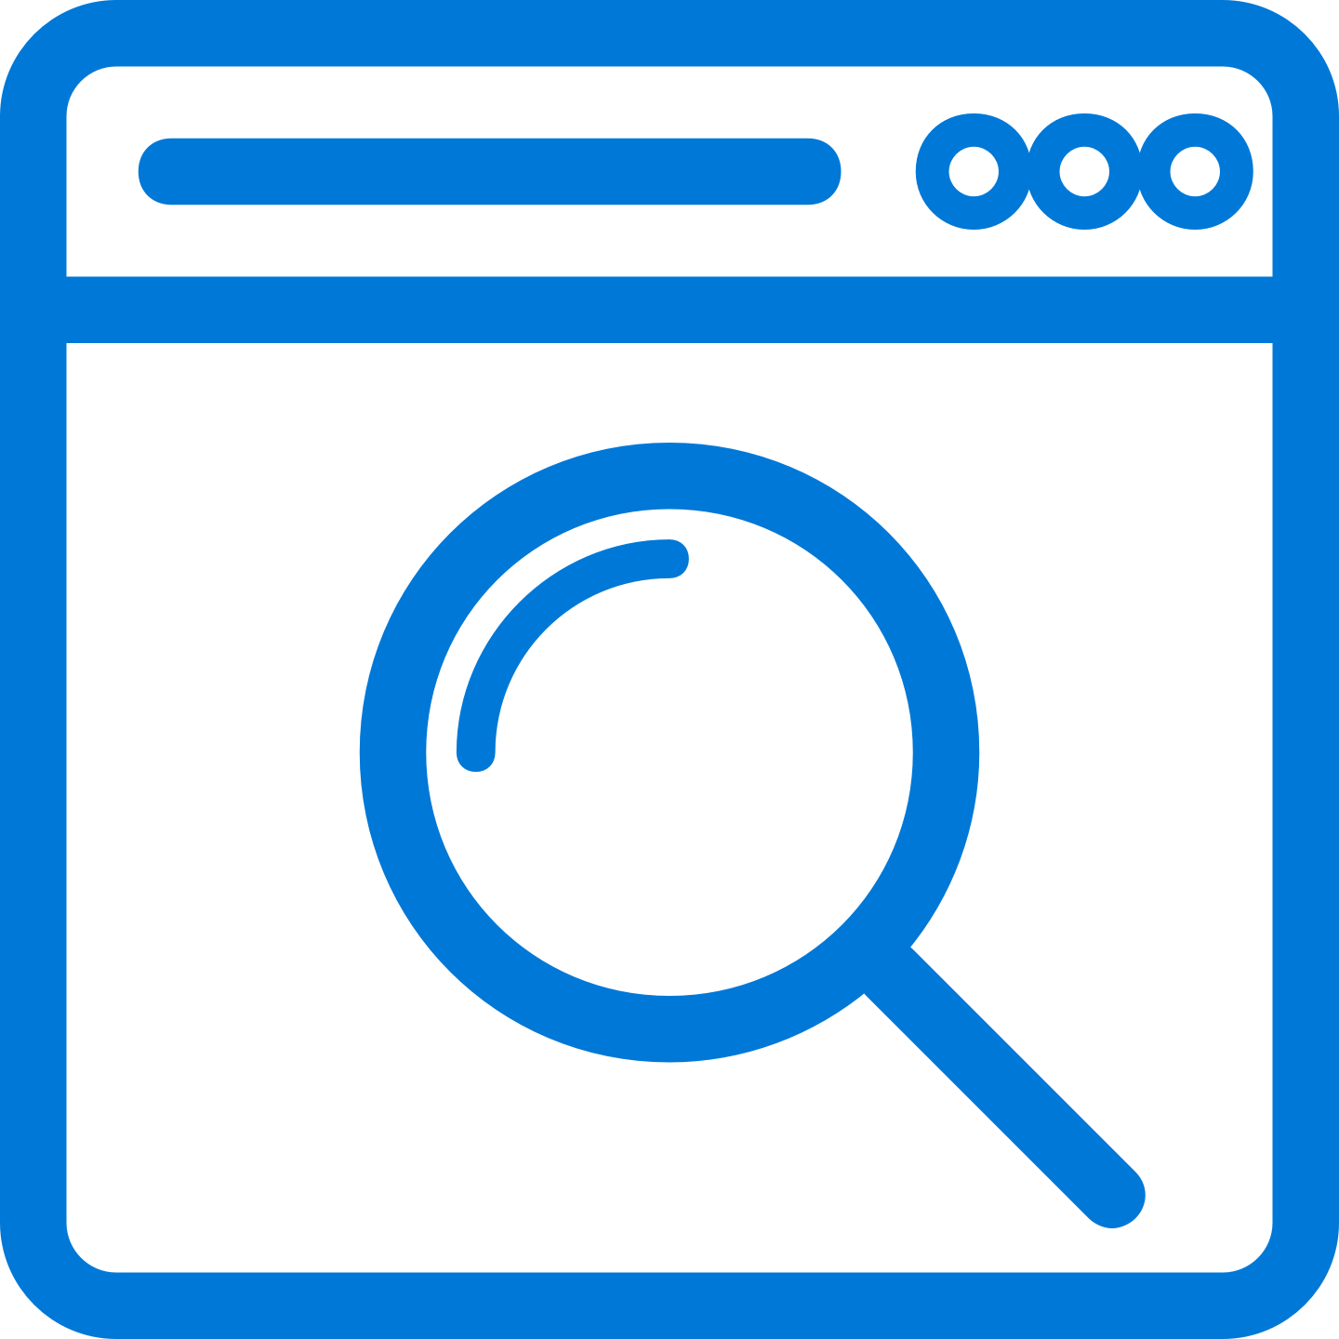
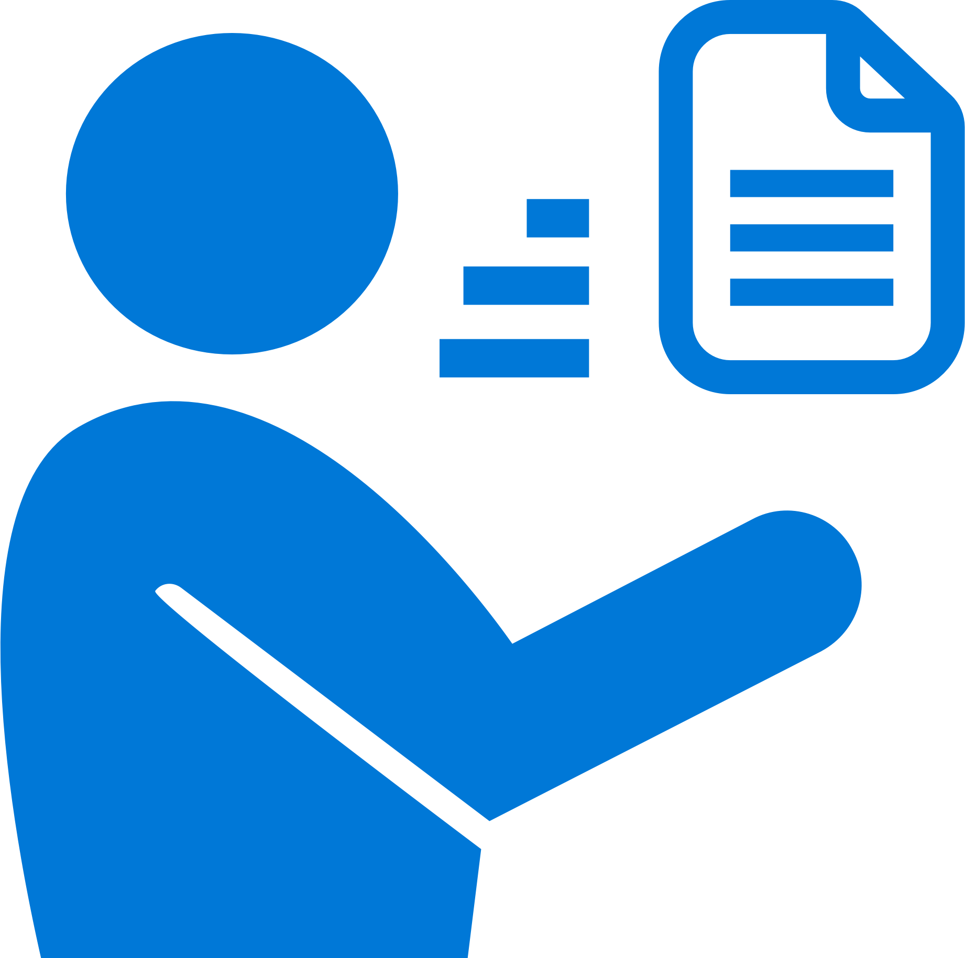
App Center: Diagnostics
Ship consistent quality
Diagnose crashes fast for maximum uptime and maintain high quality
Get real-time insights
Monitor your app health with real-time crash reports to diagnose and fix problems quickly
Do smart troubleshooting
Crashes are grouped together by similarities to focus on the most critical groups
Easily analyze data
Get detailed, easy-to-read stack traces and logs to quickly understand issues
Notes:
Integrate the SDK as described in the Getting Started with Android documentation
Add a test crash to the apps code by calling the Crashes.generateTestCrash() method of the crash reporting module as an action to a button
Run the app without the debugger connected, crash it and restart it
After a few minutes the crash report should be visible in the UI
Crash-free users per day
Crashes per day
-Up at the top you can toggle to all of the different versions of the app, set the time frame.
The status is a great team collaboration tool to let everyone working on this app know whether a not a crash is still open, closed, or if it can be ignored
You can also leave an annotation to communicate in more detail how the crash is being handled
-Groups – Immediately groups crashes based on the root cause
-Crash groups are crashes that occur in the same file in the same line - in other words if there is a crash that is occurring across a range of users, App Center Crash will automatically group those crashes together - plus it categorizes the crash groups by version, which is very useful information for dev teams
We can see the stack trace and in this particular instance it looks like… Also shows how many crashes have occurred per day, the most affected deices, and most affected OS
Drilling into Reports:
Clicking into a device - Overview will give you the general information like when the app was launched, country of origin, how long after launch the app crashed, etc.
Threads - stack trace
-Note – all of these devices are your users
Events - gives you a visualization of what occurred to cause the crash – you can create custom events by writing a small line of code on top of each event so that it’s expressed in this events tab
-This enables you to see a detailed step-by-step report of what events led up to the crash itself – so we can see when and where the crash occurred and track the user’s experience leading up to that crash
-This is extremely powerful data to be able to track – developers want to know how their users are using their applications
-Back to the Brandon Punday story
Attachments are the extra details that the developers want to collect at the time of the crash - this can be downloaded and shared with team members
Symbols: Will display unsymbolicated crashes (if there are any)
Uploaded - all of the Zip files uploaded, who uploaded them and when, plus the size
Errors: Brand new feature – this is referring to handled exceptions – Anthony mentioned we’re responsive to customer feedback – this is a perfect example of that

Slide 6
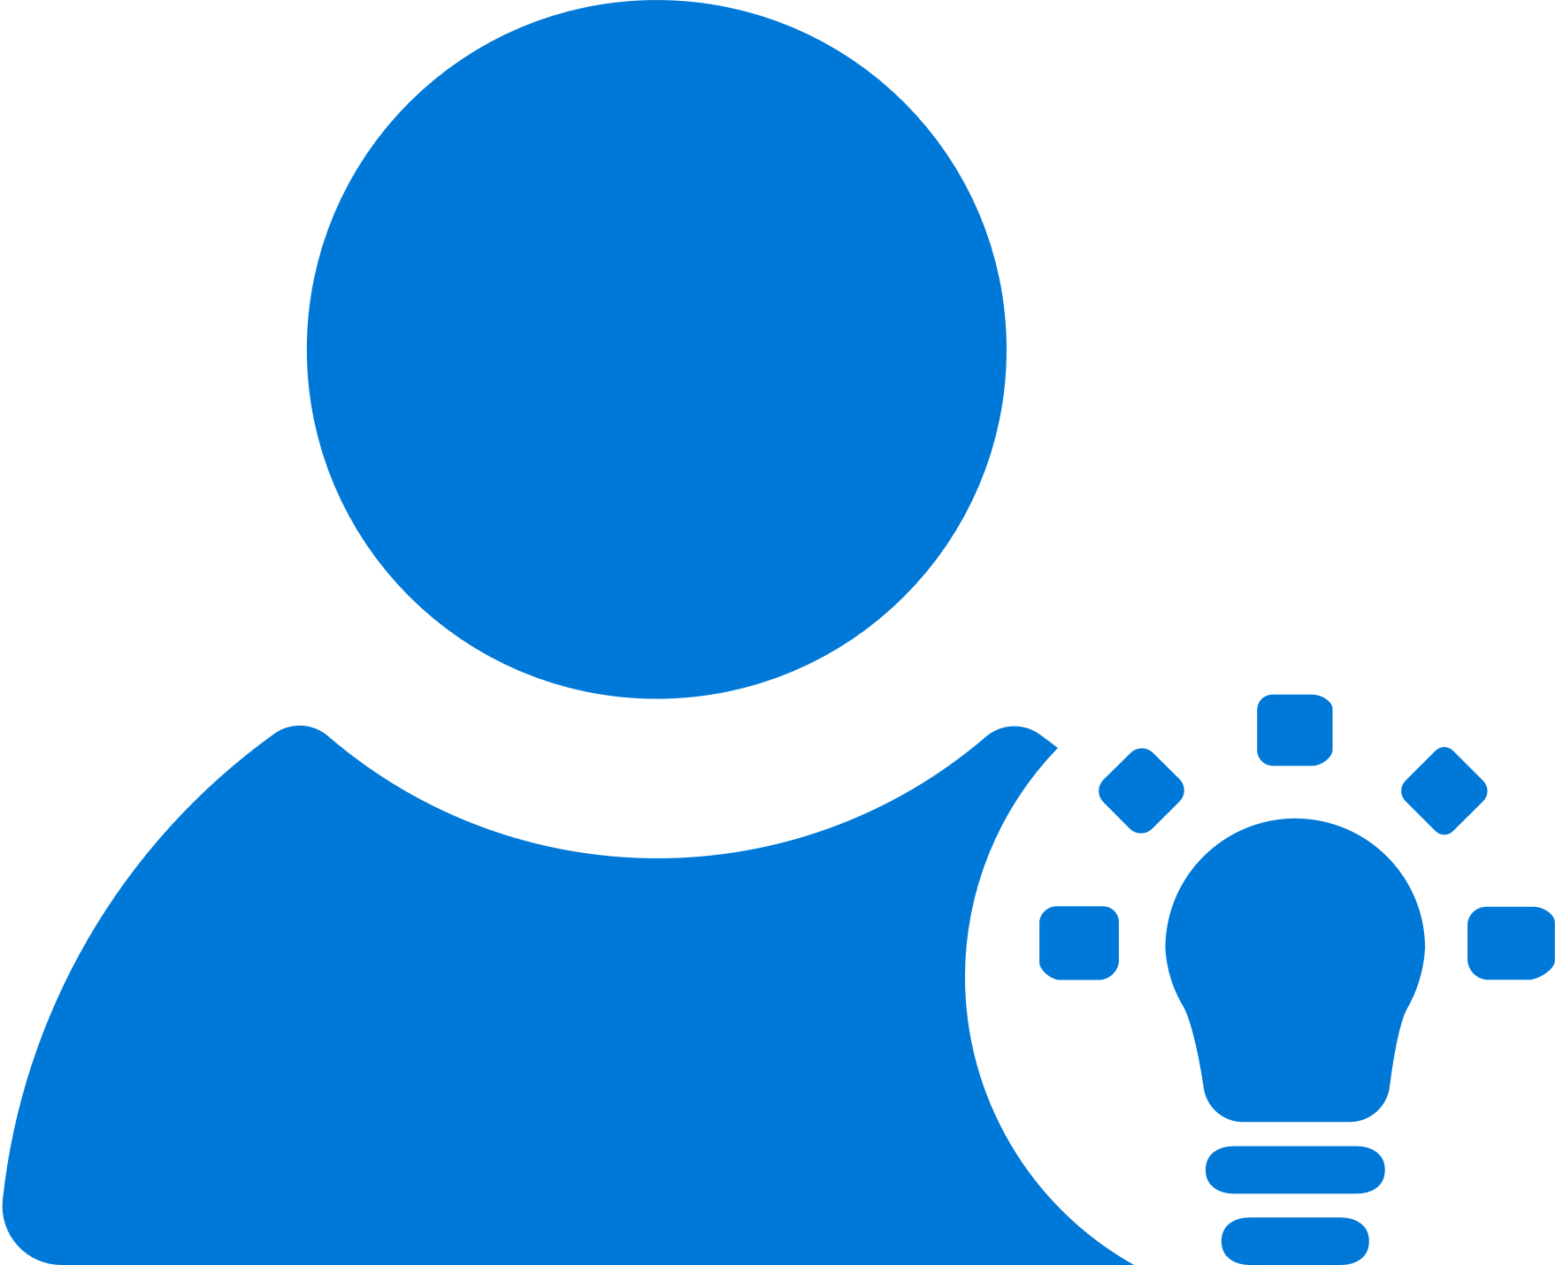
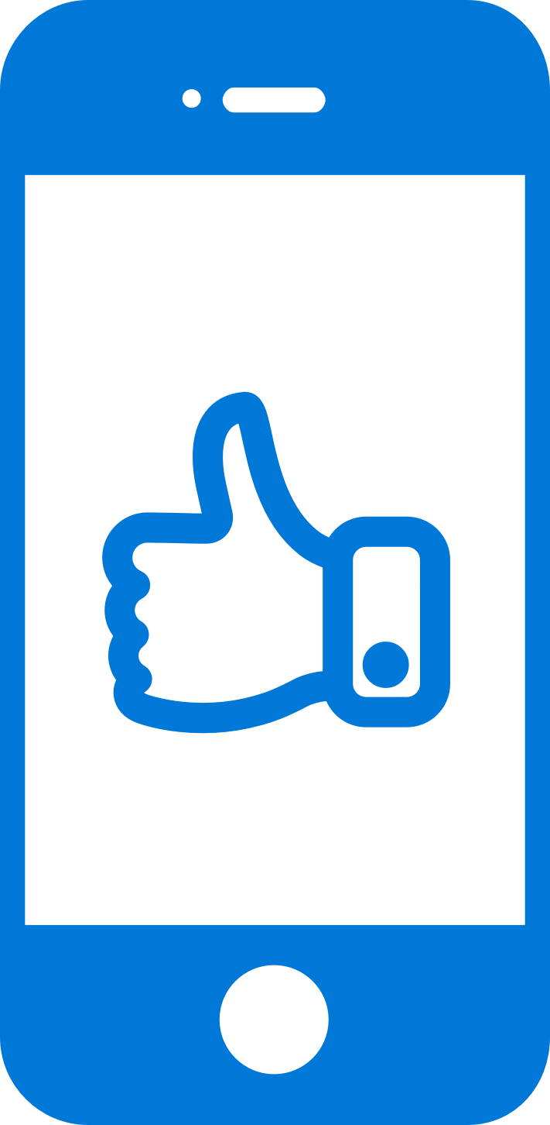


App Center: Analytics
Access instant data
Integrate the analytics SDK in just two steps to start instantaneously seeing data from your app
Understand your customers
Real-time app usage data about your core audience—devices, locations, session info, and more
Build what users want
Analyze the data to see how customers use your app and accordingly prioritize and build new features
Learn more faster
Use custom events to follow users’ actions through your app to analyze their likes and dislikes
Notes:
To properly manage your development pipeline and product strategy, you first need understand your users and how they interact with your apps. Visual Studio App Center Analytics offers free, glanceable, out-of-the-box analytics to get anyone started, and simple integration with Azure Application Insights gives even the most data-hungry business the deep insights they need.

Slide 7

App Center: Push Notifications
Fast and easy to setup
Just a few lines of code in your app. No need to specify format for iOS, Android and Windows.
Send to specific audiences
Target push notifications to specific users or devices
Fast and easy to send
Three easy steps: Compose, Target, and Review.
No need for technical skills!
Notes:
Visual Studio Mobile Center Push Notifications is really easy
-Just a few lines of code in your app
-No need to specify format for Android, iOS or Windows
-and I’ll show you how easy it is to target and send notifications to your users
Difference in Push Notifications between Notification Hub and MC

Slide 8


App Center: Push Notifications
push
Push notification services
(Apple and Google)
push
push
Notification
Hubs
Visual Studio
App Center
tokens
Notes:
How many of you are involved in mobile app dev?
How many of your apps have push notifications?
Big point of your mobile apps are to engage user and customers. Push notifications helps do that.

Slide 9
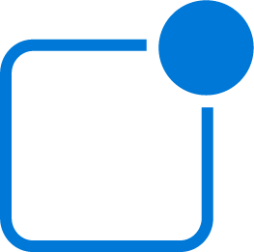
Analytics and Push Notifications
Focused Messaging
Create and send push notifications from a single portal to all app versions
Create Targeted Audiences
Use your Analytics data to create targeted audiences to help tailor messages to specific customers
Notes:
Finally, App Center is also offers support for push notifications. Instead of working through multiple portals to send messages, you can work from a single portal to create targeted audiences and messaging for a more direct connection with your users.

